Slide 1

STATUS ALERTS
Make better decisions faster and respond to business challenges and disruptions instantly

Slide 2

FLIGHT STATUS UPDATES AROUND THE WORLD IN 2023
EUROPE
181m
Statistics:
1,156,122,591
Flight status updates processed.
40
Updates per second on average (global). 111,218,080
Status messages sent in July, the busiest month.
NORTH AMERICA
ASIA-PACIFIC
720.5m
154.2m
SOUTH AMERICA
MIDDLE EAST & AFRICA
74m
25.6m
*These numbers are an average based on Global Status Messages received by OAG in 2023.
Based on departures only. Codeshare flights are included.

Slide 3


Delays and cancellations affect everybody. From travelers missing connecting flights, to employees on the tarmac, and transfer companies waiting to pick up.
With changes so often, how do you keep up to date and manage disruption efficiently?

Slide 4



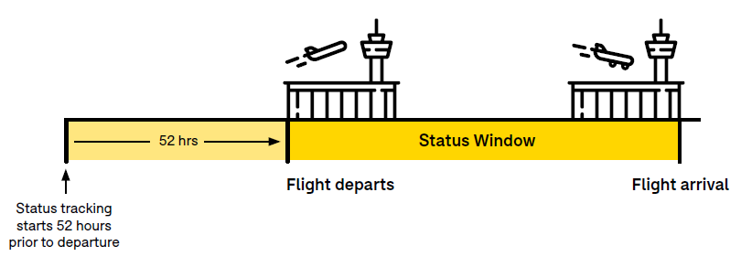
INTRODUCING STATUS ALERTS
Status Alerts delivers all changes to flights that match your criteria instantly. Tracking starts 52hr prior to departure and continues until baggage has arrived so that you don’t miss any important updates.
Delivered via Azure Event Hub, a data streaming platform, Status Alerts allows you to receive millions of flight changes within seconds and respond to business challenges immediately.
Self-service platform with flexibility to manage and change alerts at any time. Alerts stored for up to 7 days for retrieval anytime. Seamlessly integrate data and alert your customers to disruption.

Slide 5

Status Alerts, part of our Metis platform, provides a single source of truth, improves experience for your customers whilst delivering flexibility and choice for ours.
As demand for travel ramps up again post-pandemic, passengers are seeking smooth experiences and quality communication- Status Alerts helps you achieve this.
But how many changes actually happen?

Slide 6

STATUS ALERTS
*These numbers are an average based on Global Status Messages received by OAG in 2023
Based on departures only. Codeshare flights are included.

Slide 7



DON’T WANT TO SEE EVERY CHANGE?
Thanks to its high flexibility and customization, you can set up multiple different alerts with different criteria. Here’s some examples of alerts you could create;
Port
Carrier
All flights departing LHR
All flights arriving to ORD
All AMS > DXB flights
All flights operating as AA
All EK flights
U2 flights between March-September
Flight or Flight Leg
Combination
By flight number or group of flight numbers
All flights operating route KUL > SIN
Includes marketing flights
All DL flights from LAX
All flights from HND including codeshares
All U2 flights from LTN

Slide 8

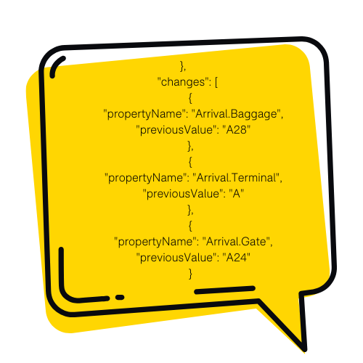

STATUS CHANGE INDICATORS & FILTERS
Change Indicators
Change indicators are supplementary data fields that allow you to see which data fields have changed from the previous update.
For example, if the previous estimated time of departure was 0800, and the latest update that was just received was 0815, change indicators would tell you that there was a change in the estimated time of departure, and what the previous value (0800) was.
Change Filters
Status Alerts now provides the option to filter out (remove) specific flight updates that may not be relevant. Allowing you to focus on the changes that matter most.
For example, if a filter is set up for all equipment changes, those changes won’t be received by the customer. Filter types include gate changes, terminal changes, baggage, aircraft type and aircraft registration number.

Slide 9



KEY BENEFITS
Built for Speed and Scale Processing up to 40 updates per second, the Alerts platform allows you to receive millions of updates in real-time, eliminating the need for manual checks.
Transform Traveller Experience Proactively make decisions faster and communicate to customers efficiently. Inform travellers as soon as there’s a disruption to their itinerary and rebook cancelled flights. Build brand loyalty with key differentiator.
Enhance Operational Efficiencies Reduce costs by only receiving updates to the flights that matter to you. Experience more agile planning by responding in real time to changes on the ground and in the skies.

Slide 10

USE CASES
Travel Tech
Say goodbye to manual checks with a faster more reliable way to react to changes
Notify your customers cancellations as soon as they happen and easily rebook travelers onto the next flight
Feed travel management systems and apps with the freshest delay data so customers always know what’s happening
Airport Services
Be more agile in your planning; responding in real time to alerts to keep resources lean and focused on the right things
Plan based on capacity to ensure you always have enough personnel at busy times
Reallocate resources quickly when a flight is severely delayed or cancelled
Airport Services
Cargo
Hospitality
Onward travel services such as Limo/Car Hire can respond to changes in real time and proactively make fast planning decisions that they can communicate to customers
Keep guest arrival times accurate by tracking any cancellations or delays to assist with housekeeping/operations
Cargo
Change alerts on live flights when status changes to enable them to respond to delays or pick up/drop off location
File for flights up to 52hr prior to departure and have them ready in a timely manner
Modify time sensitive shipments with estimated and actual delay times
Travel Tech
Hospitality

Slide 11
DATA POINTS AVAILABLE
Non Timed Status Data
Flight Status (e.g. delayed)
Aircraft Reg/Tail Number
Aircraft Type IATA
Aircraft Type ICAO
Actual Term (Dept & Arrival)
Gate (Dept & Arrival)
Diversion Airport IATA
Diversion Airport ICAO
Baggage
Timed Status Elements
Out Gate Timeliness (delayed, on time, early)
Est & Actual Out Gate (UTC + Local)
Est & Actual Off Ground (UTC + Local)
Est & Actual On Ground (UTC + Local)
In Gate Timeliness (delayed, on time, early)
Est & Actual In Gate (UTC + Local) Delay Minutes/ Variation (from Sched Dept to Sched Arrival)
General Aviation (GA) and Unscheduled Flights included (NAM only)
Technical Data
Document Type
Message Timestamp
Message ID
Operating Instance Key
Status Key
Marketing Instance Key(s)
Alert ID

Slide 12
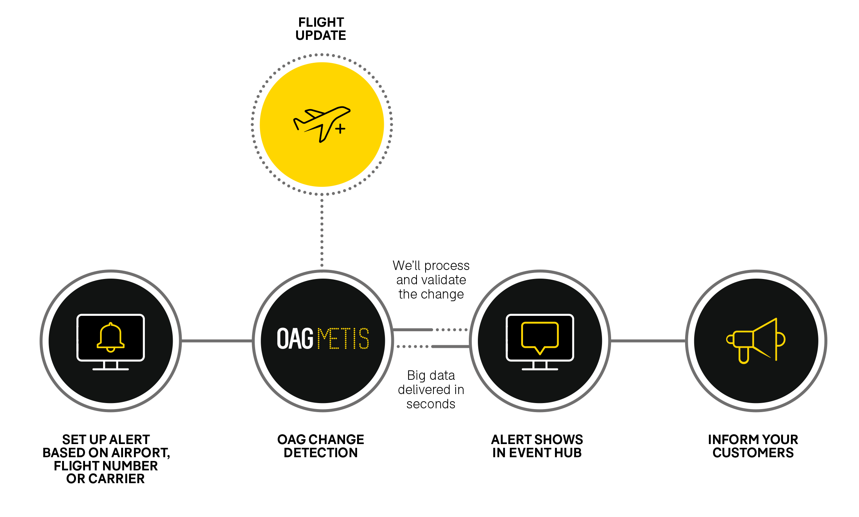
HOW DOES IT WORK?

Slide 13

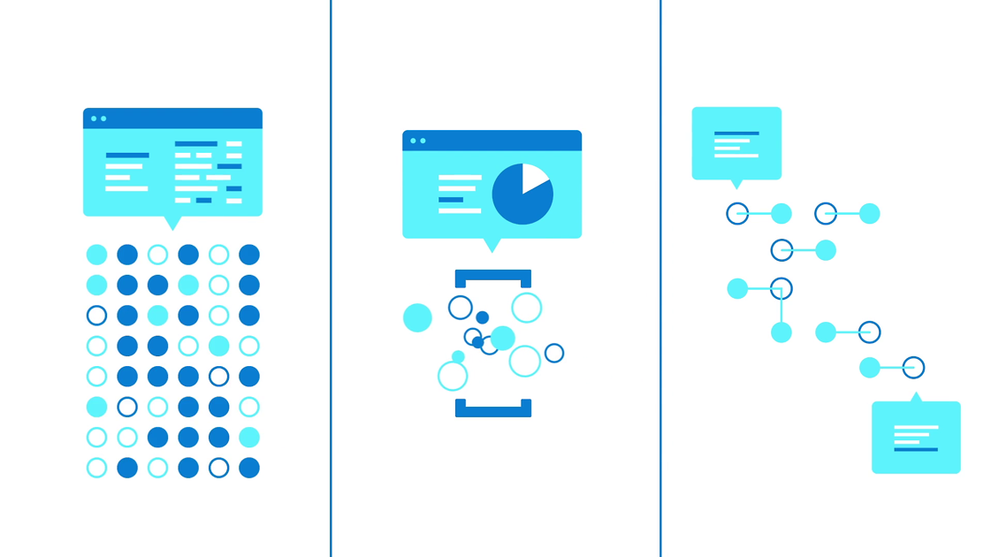
WHAT IS AN EVENT HUB?
Azure Event Hubs is a big data streaming platform and event ingestion service. It can receive and process millions of events per second.
Data sent to an event hub can be transformed and stored by using any real-time analytics provider or batching/storage adapters.

Slide 14


STATUS ALERTS IS PART OF THE FLIGHT INFO ALERTS FAMILY
SCHEDULE ALERTS
+
FLIGHT INFO ALERTS
STATUS ALERTS

Slide 15
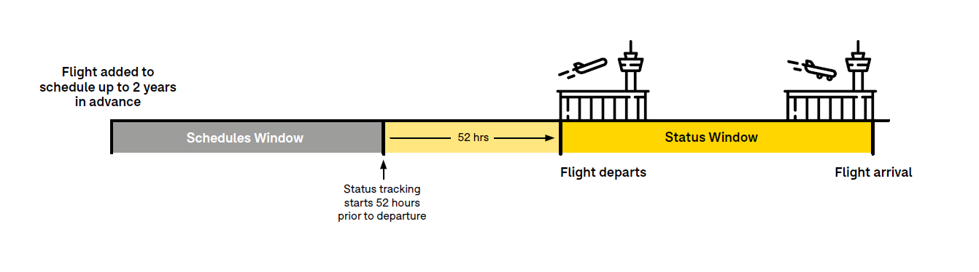
COMBINE SCHEDULES AND STATUS FOR AN END-TO-END VIEW

